Slide 1
Boat Racing Game Ryan Westwood 16th^{th} January 2020
CMP4264 2D Game Programming
BSc (Hons) Computer Games Technology
Birmingham City University, Faculty of Computing, Engineering and the Built Environment
Notes:
Hello I’m Ryan and this is Boat Racing Game.

Slide 2
Introduction to the task
The task is to create a 2D game with Unity 2019 that follows a pirate theme. The final game must have the following implemented;
Scrolling background and foreground with discernible parallaxing.
Penalty system which is displayed in fully working UI.
Four uniquely different randomly timed obstacles.
Two players.
Opponent sabotage mechanics.
Weather condition and physics.
Notes:
So The task was to create a 2d scrolling game within unity 2019 that follows a pirate theme. The game must have the following implmentations;
Discernible parallaxing
Penalty system displayed within the UI
4 randomly times challenges
2 player support
Opponent sabotage mechanics
Weather condition

Slide 3
Aims
To meet all the task requirements.
2 pirate ships (one for each player) that race for 60 seconds.
After 10 seconds the ships hit a storm and gameplay becomes twice as fast.
Each player is rewarded points for shooting rocks or killing the boss.
If the ship is struck by a rock, spike, boss bullet or red bullet they lose health.
Notes:
The main aim being to hit all the requirements for the task.
Other aims were to have functioning 2 players, a storm, rewards and penalties.
// Rewards in co-op are regain health, regain life, get points on kill, get points for killing boss.
// Solo has all these + coin collection

Slide 4
Approach
Order of steps:
Create empty methods, i.e. methods that hold no logic.
Create ships that move forwards, backwards and rotate up and down.
Add obstacles for ships to tackle during the race.
Add boundaries and background.
Add user interface.
Test for bugs.
Notes:
The project began by creating classes for all the key elements of gameplay. For example, a UI controller class, player class and an enemy class. These classes would then be filled with empty methods with what the class aims to do. Then the player classes empty methods will be filled with logic, then the obstacles classes will, then visual representations of the background and borders will be added. Laslty, UI would be incoprated to give the player visual feedback. After this was done gameplay testing began and any bugs that were found were fixed.

Slide 5
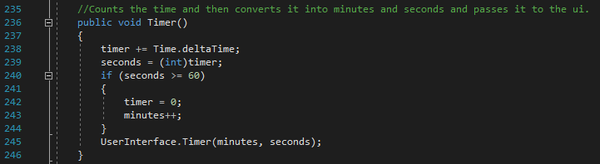
Empty method
Figure 1: Example of an empty method.
Notes:
This is an example of the empty method. Classes had multiple of these to begin with. This was used for debugging as I could check methods were being called correctly before inserting logic

Slide 6
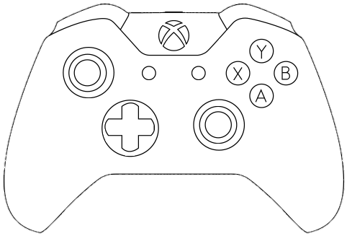
How to play the game
Constant streams of enemies will be floating toward the player. The player must evade or shoot down the enemies for 1 minute to finish the race.
W
O
A
S
D
^
SPACE
<
>
>
Player 1 keyboard controls
Player 2 keyboard controls
Player 1 and 2 controller controls
Notes:
Constant streams of enemies will be floating toward the player. The player must kill or avoid these enemies for 1 minute to survive. Player 1 uses WASD to move and Space to shoot. Player 2 uses up,down,left,right to move and O to shoot. Both players use left stick to move forwards and backwards, right stick to rotate up/down and a to shoot. At the end of 60 seconds the player with most points wins

Slide 7
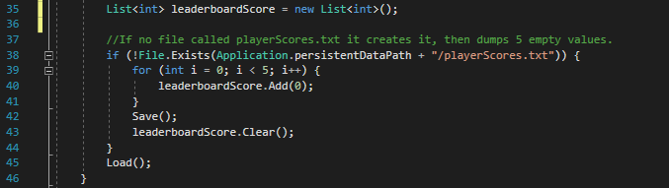
Loops and arrays
Figure 2: Looping through a list.
Notes:
List was used as it allowed for me to use .Add .RemoveAt and .Clear, this was the benefit of using list<int> instead of int[]

Slide 8
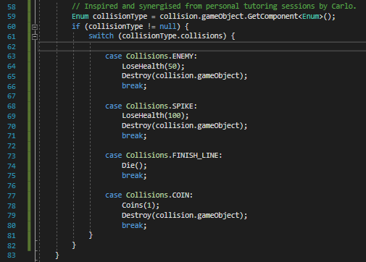
Enum
Figure 3: Using enum to get collision ID.
Notes:
This was to ID objects within the game. Used for collision detetction

Slide 9
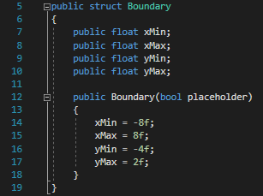
Structs
Figure 4: Struct that holds map boundaries.
Notes:
Used to holder the boundaries of the map. As a parameter less constructor isn’t possible with structs. (true) was used to initialise the values.

Slide 10
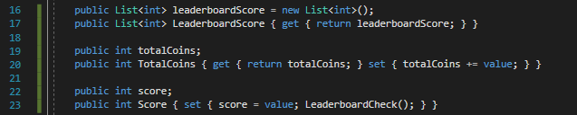
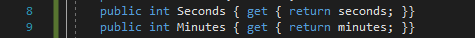
Gets and Sets
Figure 5: Leader board gets and sets.
Figure 6: Game time gets and sets.
Notes:
These are some of the gets and sets. Figure 5 handles all of the getting and setting scores to and from a text file. Whereas figure 6 is used to get the current time of the game.

Slide 11
Method 1
Figure 7: Timer method, calculates time and updates the UI.
Notes:
This is used to calculate the time since the game started, convert it into minutes and seconds. Then updates the UI

Slide 12
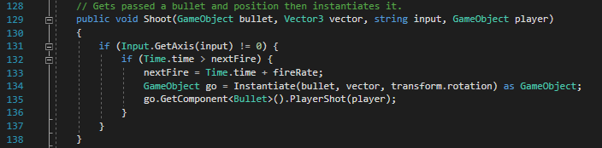
Method 2
Figure 8: Players shoot method.
Notes:
This shoots a bullet and gives the bullet the id of the player. Used to calculate which player did the last hit to the boss so they get bonus points.

Slide 13
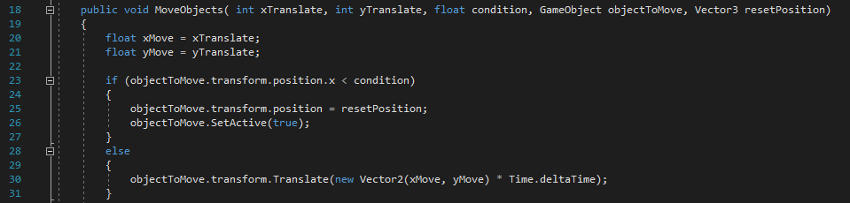
Method 3
Figure 9: Moves the background and foreground.
Notes:
This method moves the background and the foreground. Takes a lot of parameters but it saved repeated logic. But if I wanted to add a 3rd layer I could call this method and change the paramters

Slide 14
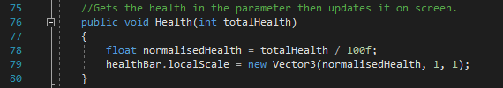
Method 4
Figure 10: Updates the players health on the UI.
Notes:
This method gets passed the players health, then converts it to a value between 0 and 1. Then sets the health bar to the vale. This works as the pivot is set to the side so 0 is an empty bar and 1 is a full bar

Slide 15
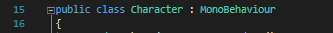
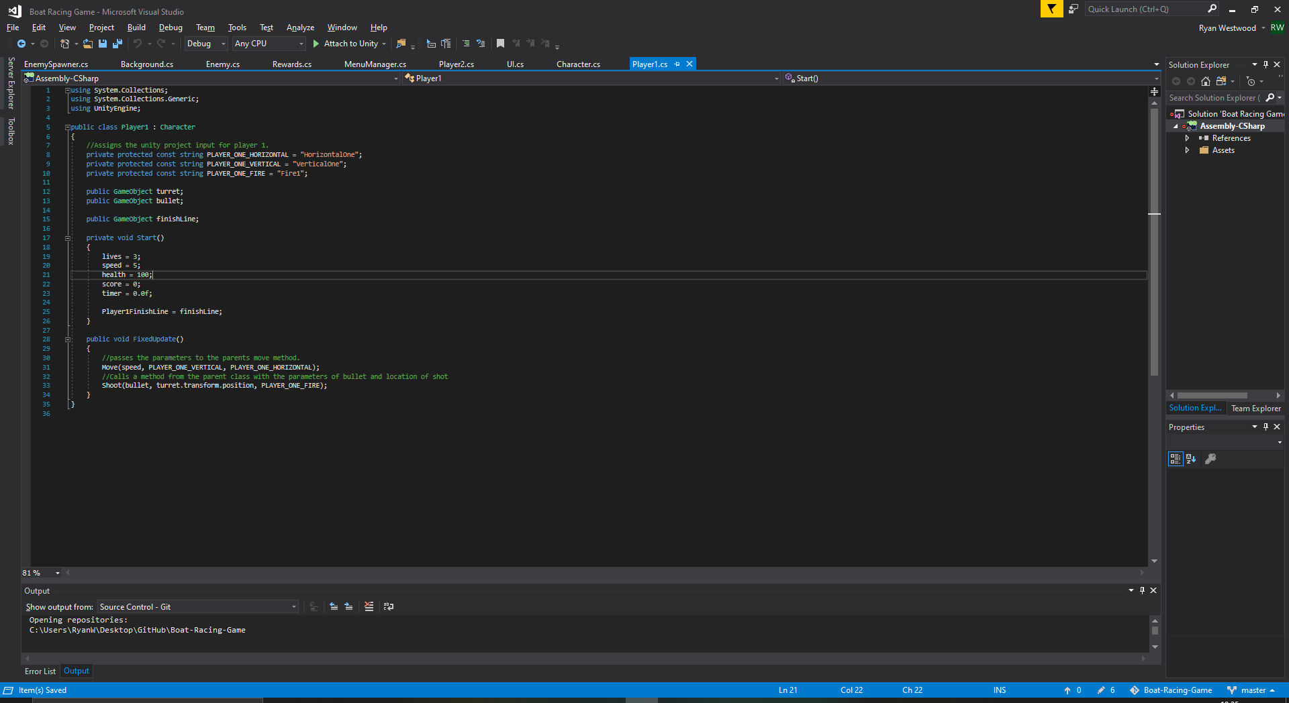
Inheritance
Figure 11: The parent class.
Figure 12: The child class.
Notes:
Character is the parent class and has all the methods such as move, shoot, health, damage. player1 and player2 are the children and inherit these methods from character so they don’t need duplicated code.

Slide 16

Encapsulation
Figure 13: Private strings used to assign player controls.
Notes:
These are encapsulated as if these values are changed the character input system will be rboken.

Slide 17
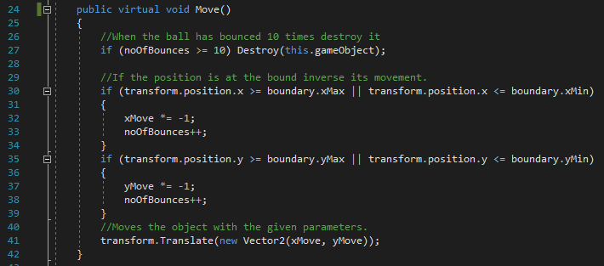
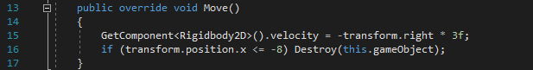
Polymorphism
Figure 14: Virtual method to be overridden.
Figure 15: Overriding the method.
Notes:
This uses inheritance similar to character. However, as the enemies are to be unique. all enemies have access to a base enemy and can override the move method to make their movement unique.

Slide 18
Achievements
4 Unique obstacles
2 Player support
Controller support
Opponent sabotage mechanics
Working leader boards
Fully functioning user interface
Discernible parallaxing
Weather mechanics
Notes:
These are all of the features the game currently has implemented and working.

Slide 19
Assets used
Assetstore.unity.com. (2019). 2D Pixel Item Asset Pack - Asset Store. [online] Available at: https://assetstore.unity.com/packages/2d/gui/icons/2d-pixel-item-asset-pack-99645 [Accessed 5 Nov. 2019].
Ferreira, B. (2019). Ocean Island Pixel Art. [online] Available at: https://nrobot.artstation.com/projects/ybl9BQ [Accessed 5 Nov. 2019].
Fontmeme.com. (2019). Pixel Fonts - Generate Text Designs with Pixel Fonts. [online] Available at: https://fontmeme.com/pixel-fonts/ [Accessed 5 Nov. 2019].
TheWolfBunny. (2019). Xbox One Controller Template. [online] Available at: https://www.clipart.email/download/1711367.html [Accessed 12 Dec. 2019].
Notes:
These are all the assets used to create the game.

Slide 20
Any questions?
Notes:
These are all of the features the game currently has implemented and working.

